Slide 1
Logistics: Assignment 3 and Project Milestone 1
Assignment 3: Due Oct 18 (Mon)
Don’t wait till the last minute
Check your late-day usages
Project milestone 1: Due tomorrow, Oct 15 (Fri)
Initial literature survey (around 3~5 references)
A plan on what you want to do for the remaining of the semester
Formalize your research question and approaches, e.g.,
Theory/simulation project: formalize your models
Data-analysis project: figure out where and how to get data and what you plan to do with it
Experiment/application project: have a prototype design and an evaluation plan
Include a timeline (weekly or biweekly) on what you plan to do
Nov 2: Midterm Project Pitch and Discussion
Nov 5: Milestone 2

Slide 2
Logistics: More about Assignment 3
Understanding Bayes’ theorem and conditional probability
Problem 2
Assignment prior: 80% good, 20% bad
Two randomly drawn graders 1 and 2 are reviewing the same assignment
What is the probability for a grader to receive signal B for an assignment randomly drawn from all assignments
Conditional on the event that grader 1 receives signal B, what is the probability that grader 2 (grading the same assignment) also receiving signal B?
If you don’t know how to approach the above problems right on top of your head, you might have a hard time for assignment 3.

Slide 3
Logistics: More about Assignment 3
Understanding Bayes’ theorem and conditional probability
Problem 3
Recommendation letter writing as Information design
Qualification prior: 30% above the bar, 70% not above the bar
Consider a letter writing strategy:
When the student is above the bar, I say the student is above the bar with 100% chance
When the student is not above the bar, I say the student is above the bar with 20% chance
When the company receives a letter saying the student is above the bar
What is the posterior probability that the student is really above the bar

Slide 4
Logistics: Project Milestone 2
Milestone 2: Due Nov 5
Summarize your progress
Last chance to convert a research project to an extensive literature survey
What’s the expected amount of literature survey?
Case by case
As a general guideline, the minimum number of papers
For research project: 3~5 papers (# papers in one lecture)
For literature survey project, 15~20 papers (# papers in one “topic”)

Slide 5
Logistics: Project Midterm Pitch and Discussion
Milestone 2: Due Nov 5 (Friday)
Midterm Pitch: Nov 2 (Tue), in lecture
More details to come
Tentative formats:
Every team gives a spotlight presentation for 1~2 min
The entire class splits into 3 big groups
Each team in turn obtains the entire attention of the big group
Using this time to collect data, obtain feedback, get suggestions, etc
Try to think about what you can do with this time in your milestone 1 plan and utilize it
Let me know early if it’s helpful to utilize the entire class for help
Might be able to allocate a small amount of time in a need basis

Slide 6
Student Presentation
Remember to submit the peer review form by 6pm

Slide 7
Lecture 13 Real-time Crowdsourcing
Instructor: Chien-Ju (CJ) Ho

Slide 8
Crowds in Two Seconds [Bernstein et al. UIST 2011.]

Slide 9
VizWiz [Bigham et al. UIST 2010]
Answer Blind People’s Visual Questions

Slide 10
Crowd-Powered Chatbot [Huang et al. HCOMP 2016]
There are impressive progress in Chatbots, but it’s still not good enough
A crowd play as a chatbot by
Propose responses
Vote for the best one
Take notes
Intermediate solutions; dataset generation

Slide 11
Auto-Evolving Crowd Chatbot [Huang et al. CHI 2018]
Train AI chatbots with historical data
A crowd consists of both humans and AIs
Propose responses
Vote responses
May even consider dynamically determining the ratio of AIs

Slide 12
Auto-Evolving Crowd Chatbot [Huang et al. CHI 2018]

Slide 13
Task Delegability
When are humans preferred than AI in doing tasks
Humans can do better than AI
Ethical/legal concerns or trustworthy issues
We want humans to do the tasks

Slide 14
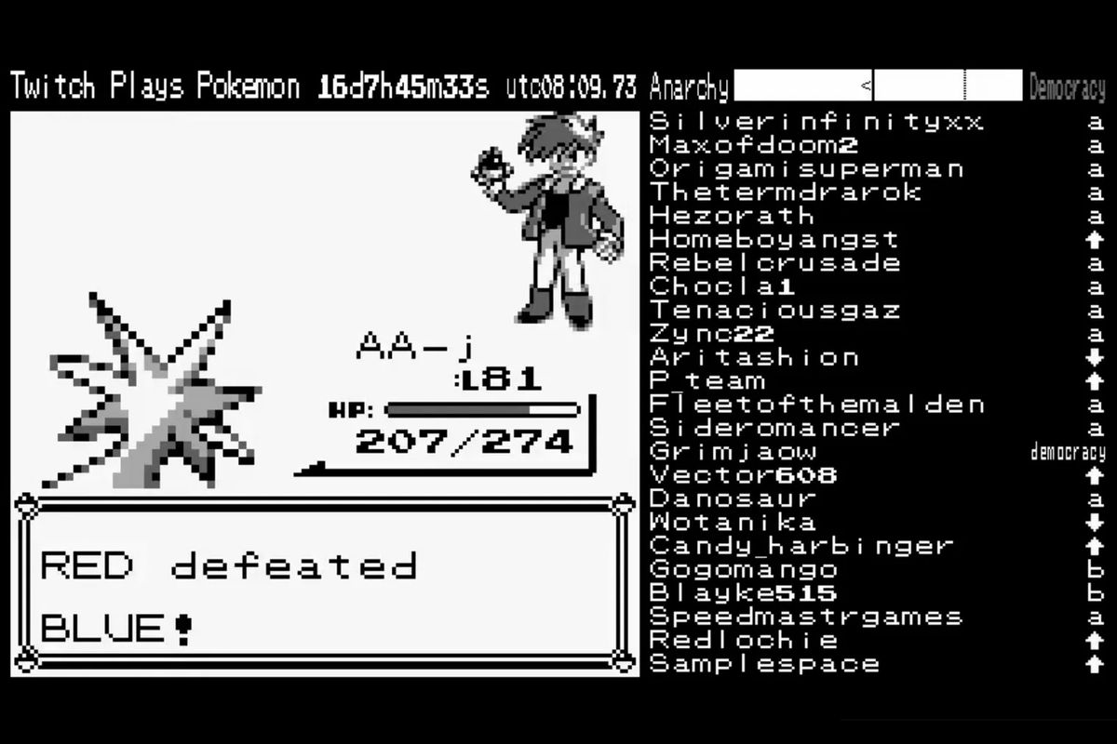
Twitch Plays Pokemon
https://www.twitch.tv/twitchplayspokemon

Slide 15
Twitch Plays Pokemon
Guinness World Record:
"the most participants on a single-player online videogame" with 1,165,140
Best Fan Creation in Game Award 2014
An application “for fun”, not to “solve problems”
Highlight an interesting question
How should we decide which action to take?
Challenging for sequential actions under real-time constraints

Slide 16

Example: Crowd Robot Navigation [Lasecki et al. UIST 2011]

Slide 17
Discussion
What do you think are the efficient ways for crowd control?
You can use the robot navigation as the application.
Or imagine you are together with 10 other people in a critical environment. You together need to make a series of decisions to survive under time pressure. What’s the mechanism you think you should use?

Slide 18
Crowd Robot Navigation [Lasecki et al. UIST 2011.]
Solo: Hire a single worker
Mob: Pass on all inputs to the original interface (first come first serve)
Vote: Follow actions by majority vote
Leader:
Update “weights” of users based on agreements with the crowd
Follow the actions by the leader (which might change over time)
Active:
Randomly select a worker as the leader, change worker if the input is not in on time

Slide 19
Crowd Robot Navigation [Lasecki et al. UIST 2011.]
Performance measure
Number of success (out of 10)
Average time to complete the task when succsess

Slide 20
Generally, how to aggregate preferences from a crowd?
Social choice theory

Slide 21
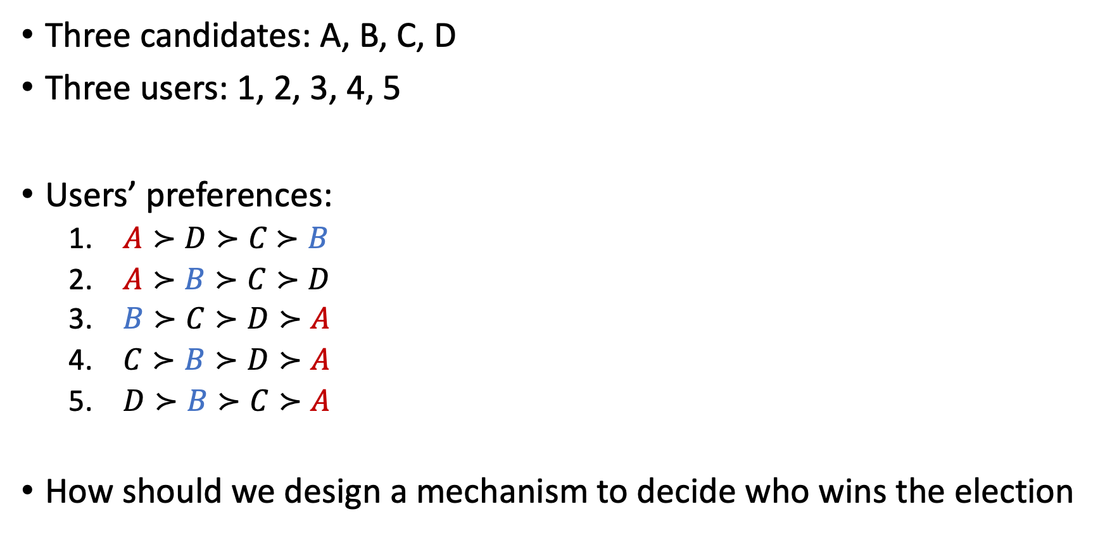
Consider Elections
Three candidates: A, B, C, D
Three users: 1, 2, 3, 4, 5
Users’ preferences:
$A≻D≻C$ $≻B$
$A≻B≻C≻D$
$B≻C≻D≻A$
$C≻B≻D≻A$
$D≻B≻C≻A$
How should we design a mechanism to decide who wins the election
Assuming we use majority voting:
Everyone gives one vote
The candidate with the most votes win
Will everyone just vote for their favorite candidate?

Slide 22
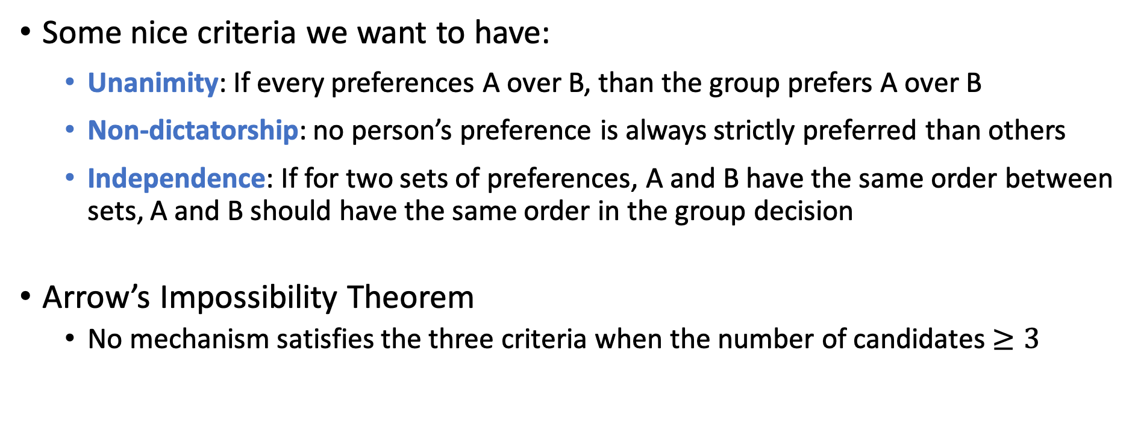
Arrow’s Impossibility Theorem
Some nice criteria we want to have:
Unanimity: If every preferences A over B, than the group prefers A over B
Non-dictatorship: no person’s preference is always strictly preferred than others
Independence: If for two sets of preferences, A and B have the same order between sets, A and B should have the same order in the group decision
Arrow’s Impossibility Theorem
No mechanism satisfies the three criteria when the number of candidates $≥3$

